Slide 1
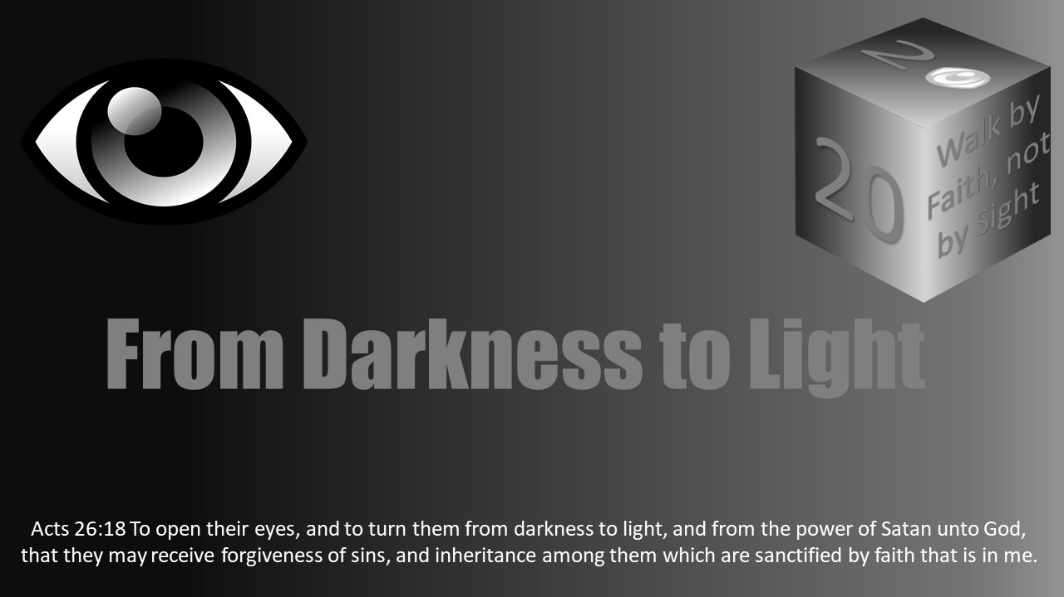


Slide 2
Darkness Lesson 18: Eye For An Eye
The Devil’s Dark Distortions: Abortion

Slide 3
Introduction
Exodus 21:22-25 (ESV) reads, "When men strive together and hit a pregnant woman, so that her children come out, but there is no harm, the one who hit her shall surely be fined, as the woman's husband shall impose on him, and he shall pay as the judges determine. But if there is harm, then you shall pay life for life, eye for eye, tooth for tooth, hand for hand, foot for foot, burn for burn, wound for wound, stripe for stripe.”
What was meant by an "eye for an eye?"
The scenario in the text was the unintentional injury or termination of a pregnancy should be punished.
This was under the Law of Moses here as well as for false testimony in Deuteronomy 19:21 and injury to a neighbor in Leviticus 24:20.

Slide 4
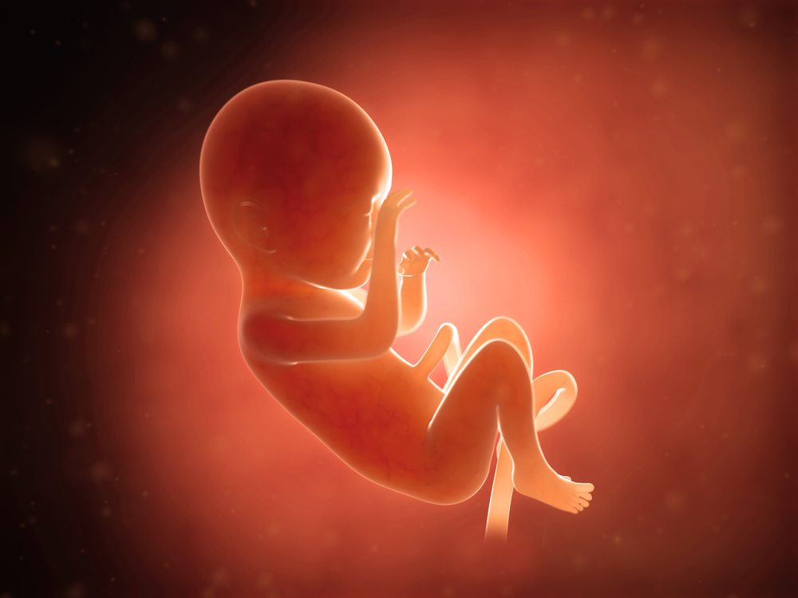
Introduction
The scenario Exodus 21was the unintentional injury or termination of a pregnancy should be punished. This was under the Law of Moses here as well as for false testimony in
Deuteronomy 19:21 and injury to a neighbor in Leviticus 24:20.
What about those who purposefully terminate pregnancies today?
Is abortion sinful because it willfully takes a human life?
Is abortion murder?

Slide 5

Introduction
In Romans 1, Paul describes a culture whose hearts are darkened and their minds reprobate having become futile in their thinking toward God.
They have moved beyond feeling, turning truth into a lie.
Among the list of sins in verse 31, Paul refers to people "without natural affection.”
Those who do not have the love and attachment as nature teaches mothers to have for their children is descriptive of the American culture through abortion.

Slide 6
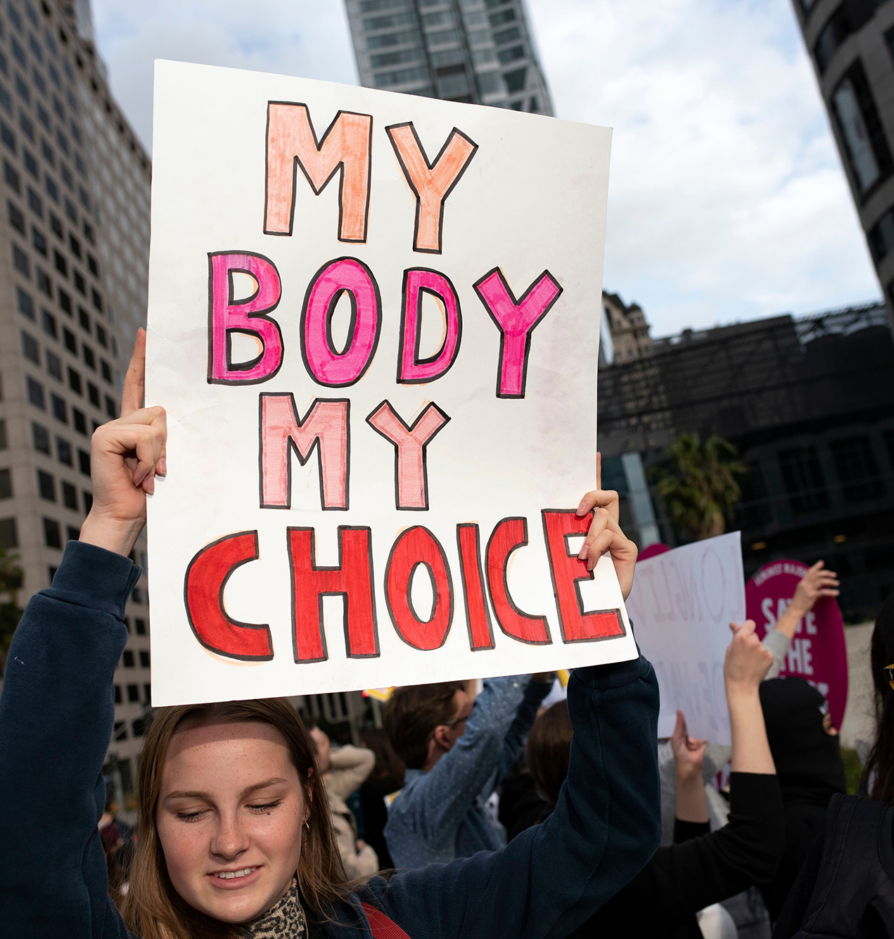
Introduction
Not only is abortion common and demonstrates a lack of natural affection, but society defends abortion as a woman's right to do with her body as she pleases.
Political opposition to halting abortion is so vehement; it presents a view that such oppositional actions are cruel. Such arguments change the truth into a lie.
The unborn child is in her body and supported by her body, but the separate cells of the child's body indicate it is not just her body.
It is a life.
Isaiah speaks of those who turn darkness into light in 5:20: “Woe unto them that call evil good, and good evil; that put darkness for light, and light for darkness; that put bitter for sweet, and sweet for bitter!”
Abortion is an action without natural affection.

Slide 7
Introduction
"This expression [without natural affection] denotes the want of affectionate regard towards their children. The attachment of parents to children is one of the strongest in nature, and nothing can overcome it but the most confirmed and established wickedness. And yet the apostle charges on the heathen generally the want of this affection. He [doubtless] refers here to the practice so common among heathens of exposing their children, or putting them to death. This crime, so abhorrent to all the feelings of humanity, was common among the heathen and is still. The Canaanites, we are told, (Psa. cvi. 37, 38) 'sacrificed their sons and their daughters unto devils, and shed innocent blood, even the blood of their sons and daughters, whom they sacrificed unto the idols of Canaan.' Manasseh, among the Jews, imitated their example, and introduced the horrid custom of sacrificing children to Moloch, and set the example by offering his own, 2 Chron. xxxiii. 6. Among the ancient Persians, it was a common custom to bury children alive. In most of the Grecian states, infanticide was not merely permitted but actually enforced by law" (Barnes' Notes On The New Testament).

Slide 8
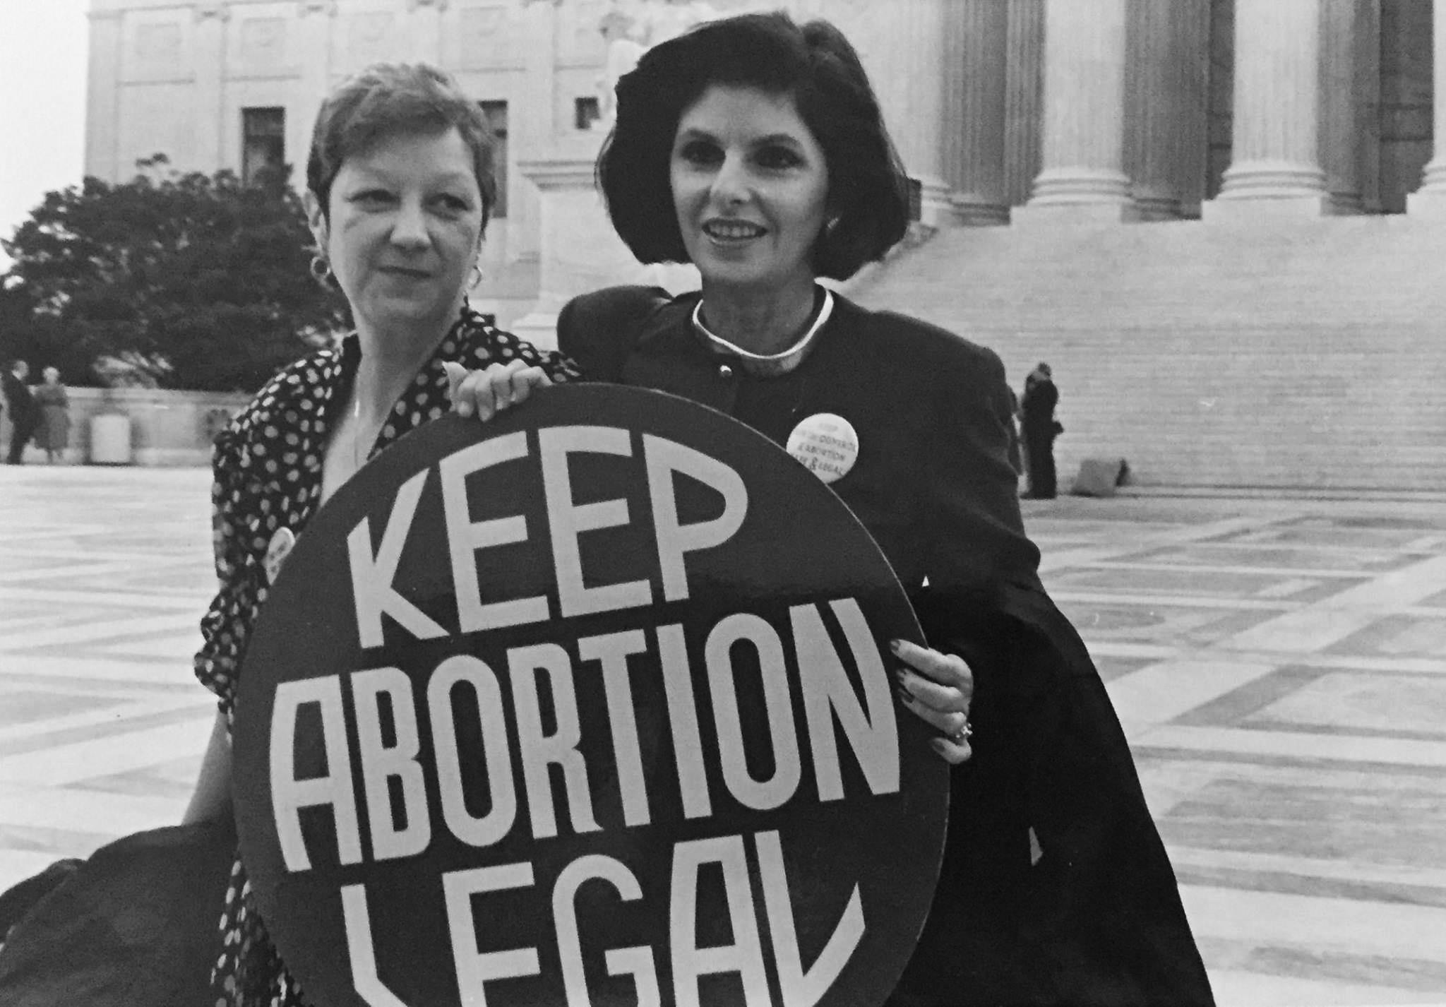
How Common Is Abortion in The United States?
The murder of young children has been practiced by many cultures and people. The Nazi Holocaust started with the slaughter of thousands of "defective" citizens, culminating in the death of over 12 million.
Since the legalization of abortion in the United States through Roe V. Wade in 1973, over 58 million have been killed by abortion at this writing in January 2018.
Aborted bodies are often incinerated at a clinic or disposed of in dumpsters. There are no funerals or coffins for the bodies of these unborn. In 2017, some abortion facilities were found trading body parts of aborted children.

Slide 9
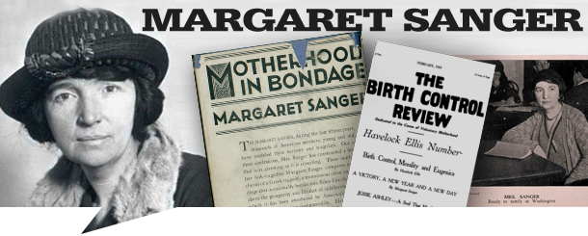
How Common Is Abortion in The United States?
Historically, Margaret Sanger often promoted abortion out of racism and eugenics to improve the genetic composition of the human race.
Even now, abortion is five times more common in women of color than Caucasians.

Slide 10
How Common Is Abortion in The United States?
The facts of staggering. There were approximately 1.1 million abortions in the United States in 2011 or 16.9 abortions for every 1,000 women of childbearing age. This is lower than the rate of 29.3 per 1000 women of childbearing age in 1981.
The abortion to live births ratio has been decreasing since 1984 when it was 364 abortions for every 1000 live births.
However, the number of murders/abortions is incredible despite the rate reduction.
(https://www.theatlantic.com/health/archive /2014/09/abortions-racial-gap/380251/).

Slide 11

How Common Is Abortion in The United States?
Globally, 25% of pregnancies ended in abortion in 2010–2014.
In developed countries, the proportion declined from 39% to 27% between 1990–1994 and 2010–2014, whereas it increased from 21% to 24% in developing countries. (guttmacher.org Sept 2017 fact sheet).
Less than 1% of abortions are estimated to be because of rape, incest, maternal health problems, and childbirth defect.

Slide 12
How Common Is Abortion in The United States?
From 1973 to 2018, over 58.6 million children have been aborted in the United States. At this writing in January 2018, the CDC most recent statistical analysis was available from 2013 (https://www.cdc.gov/mmwr/volumes/65/ss/pdfs/ss6512.pdf).
To put this in perspective, a recent analysis of all Americans lost in wars tallied over 2.8 million from the Revolutionary War to a soldier lost in the raid in Yemen in 2017 covering 242 years of history.

Slide 13
How Common Is Abortion in The United States?
In 2014 alone, there were 926,200 abortions in the United States.
Of those seeking an abortion, 18% were under 20
Adolescents made up about 12% of abortion-seeking patients.
And, it has been estimated 5% of women by age 20 will have had an abortion. (https://www.guttmacher.org/fact-sheet/induced-abortion-united-states).
It is a fact, abortion is common in American society.

Slide 14
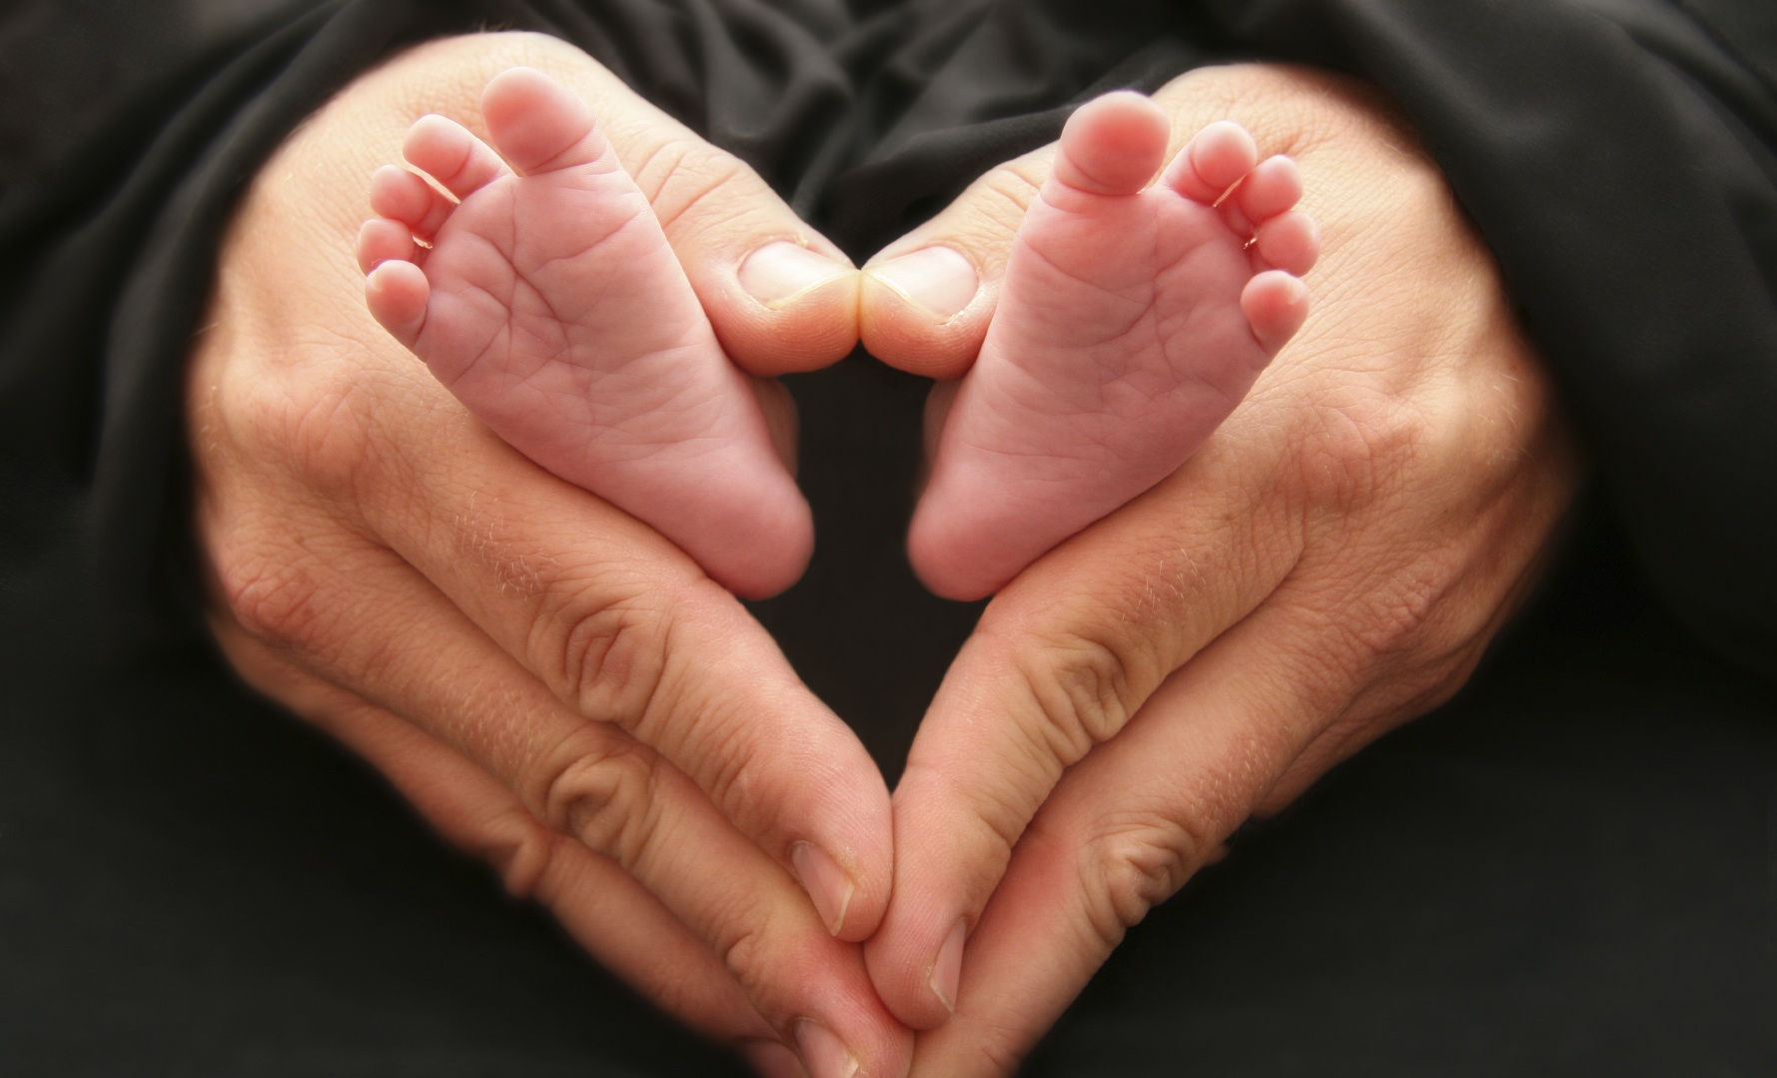
Some Perspective from Scripture
The Mosaic Law called for an eye for an eye in accidental cases.
Abortions are not accidental; they are deliberate.
Many call for people to see those aborted as blobs of cells.
They use alternative labels such as fetus.
Nor do they like to view them as children.
Ask the hopeful parent if they see the living being inside as their child; their answer will be different.

Slide 15
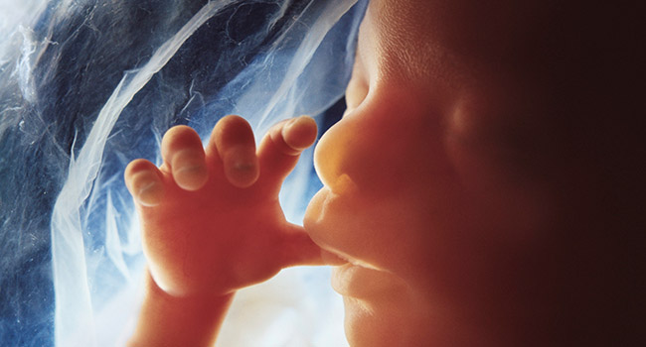
Some Perspective from Scripture
King David was not fully developed but God knew him in his mother's womb.
He describes himself this way in Psalms 139:13-16, "For you formed my inward parts; you knitted me together in my mother's womb. I praise you, for I am fearfully and wonderfully made. Wonderful are your works; my soul knows it very well. My frame was not hidden from you, when I was being made in secret, intricately woven in the depths of the earth. Your eyes saw my unformed substance; in your book were written, every one of them, the days that were formed for me, when as yet there was none of them.”

Slide 16
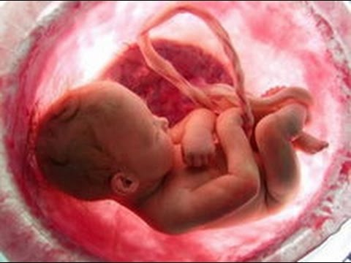
Some Perspective from Scripture
Perhaps the younger David could not have breathed or survived outside his mother's womb, but he was alive and had a relationship with God.
There are cases of children surviving birth with medical care as young as twenty weeks.
Some proponents of abortion want to extend the legal right for abortion through nine months.

Slide 17
Value of Life
Humans have genetic and birth defects. And, some create their own impairments later in life.
Although not referring to abortion at the time, my friend, Cindy Childers, expressed the value of life this way, “Does your life have purpose? Does our life have hope? Our life doesn’t have to be perfect in order to have these things. In fact, God usually takes the least from among us who have truly humbled themselves to take on His greatest plans. But it is hard to see this while in the middle of a trial or a painful situation.” (Cindy Meyer Childers, Personal Facebook Page on 1/23/18).

Slide 18

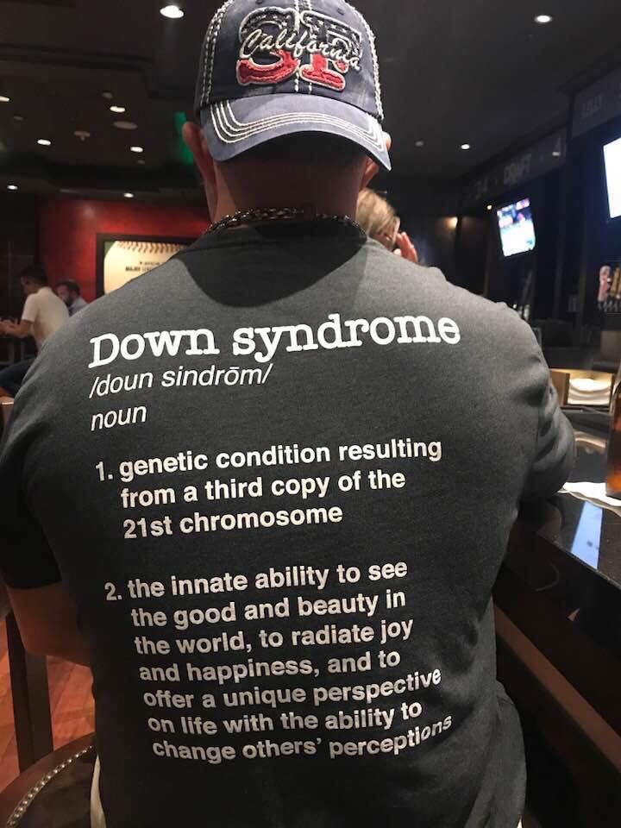
Value of Life
I am not perfect. Nor are my children perfect. My oldest son is autistic. However, no matter the imperfection, I am such a proud father of both my children.
I also have a friend who has a wonderful child with Down syndrome.
Many parents have children who have problems with their health or neurological status, but you typically do not hear these parent lament that they had this child.
I have observed many children, but the happiest and most smile causing child I have seen has Down syndrome.
When the abortionist suggests we terminate these children, my heart fills with horror and indignation! These children have a life worth living, even with their impairments.

Slide 19
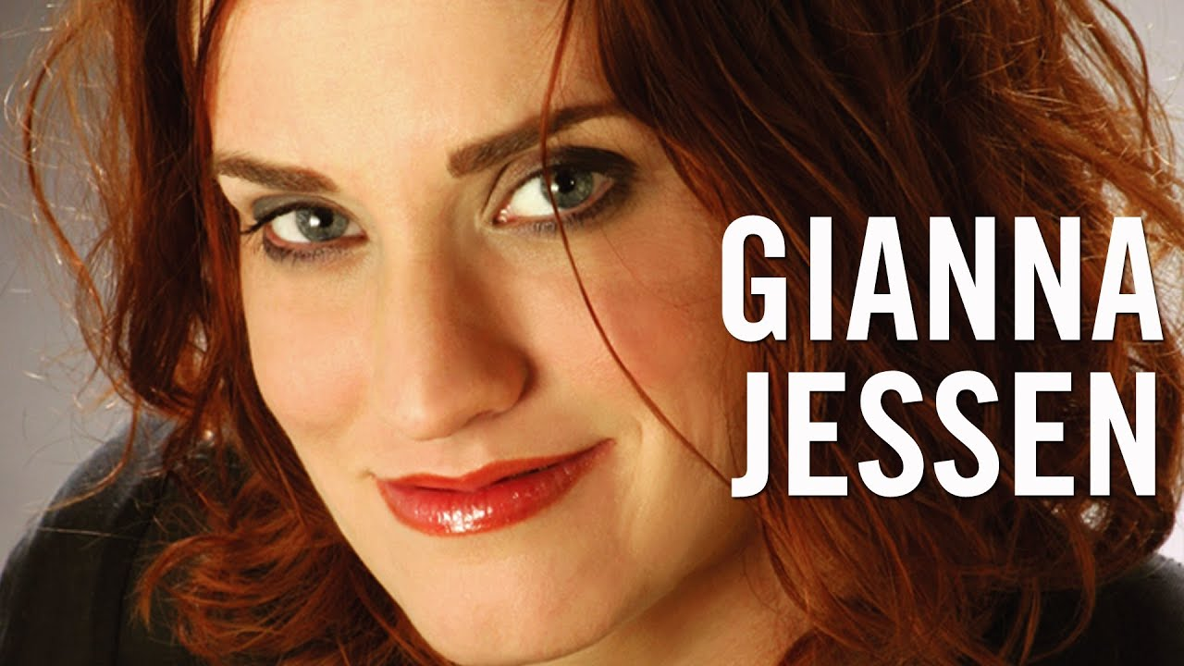
Value of Life
If you take the time to query “abortion survivor,” you can read the testimony of women such as Gianna Jessen and others, who survived a failed abortion and went on to lead strong productive lives.
All humans, no matter their less than perfect status, have a place and purpose.
As with the blind man who Jesus put mud on and commanded him to wash in the pool, God had a purpose to use this man to His glory (John 9:4).

Slide 20
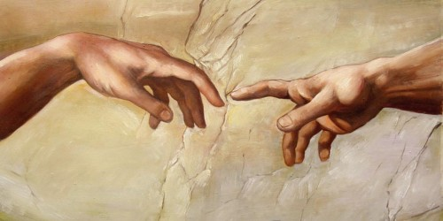
Value of Life
I have worked inside maximum security prisons; clearly, some men have become as brute beasts.
However, if they are created in the image of God, then they have worth when redeemed.
God created humans in His image (Gen 1:27; Gen 9:6; James 3:9).
All humans have the same soul and an opportunity to use their lives to serve or not serve Him.
You might think impressive wealth, athletic prowess, scholarship, or skills in a particular area will impress, but God is interested in what you did with the soul He gave you.
Too many forget the widow who gave her small amount was greater than those who gave and filled the treasury; She gave her all (Mark 12:39-42).
God does not need a person’s help, but a person needs God to recognize their efforts.

Slide 21
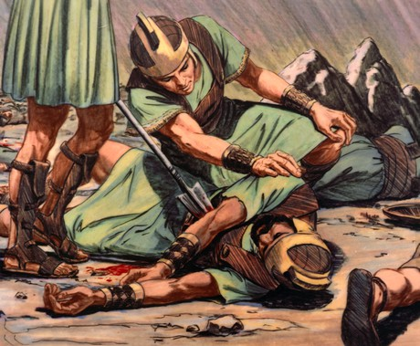
Value of Life
There is no example of abortion in the scriptures.
However, David and Bathsheba had an unwanted pregnancy in 1 Samuel 11 and 12.
King David committed adultery with Uriah's wife.
To hide the illegitimate child, David had Uriah killed.
David's plan to kill the innocent to protect the guilty is similar to what many do today, except he killed an adult man through his status as king.

Slide 22
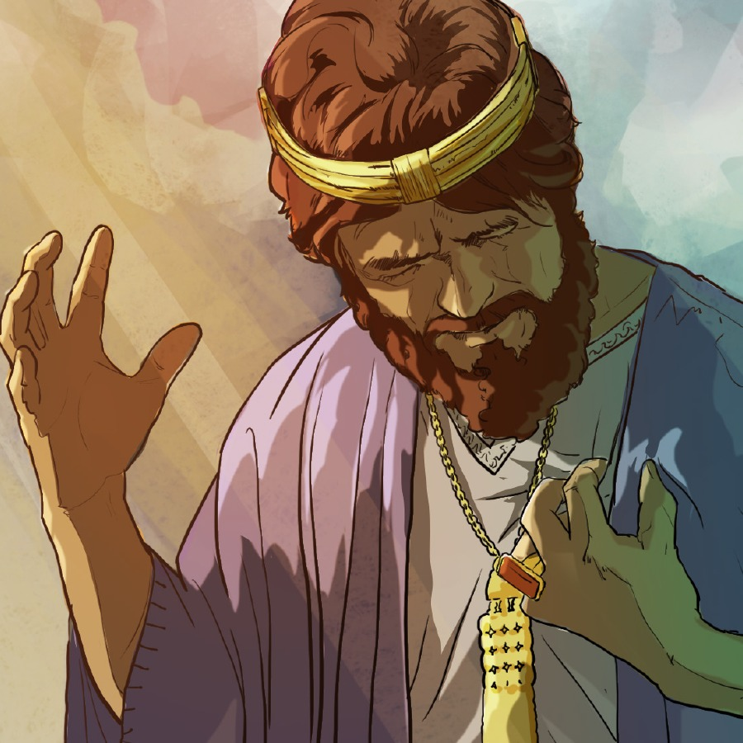
The Way of The Transgressor
Proverbs 13:15 says the way of the transgressor is hard.
Living with the guilt of abortion is indeed hard.
David sought repentance in Psalms 51 for his past sins.
Those involved in abortion from their past can as well.

Slide 23
The Way of The Transgressor
David begs for repentance in Psalms 51:1-14, "Have mercy on me, O God, according to your steadfast love; according to your abundant mercy blot out my transgressions. Wash me thoroughly from my iniquity, and cleanse me from my sin! For I know my transgressions, and my sin is ever before me. Against you, you only, have I sinned and done what is evil in your sight, so that you may be justified in your words and blameless in your judgment. Behold, I was brought forth in iniquity, and in sin did my mother conceive me. Behold, you delight in truth in the inward being, and you teach me wisdom in the secret heart. Purge me with hyssop, and I shall be clean; wash me, and I shall be whiter than snow. Let me hear joy and gladness; let the bones that you have broken rejoice. Hide your face from my sins, and blot out all my iniquities. Create in me a clean heart, O God, and renew a right spirit within me. Cast me not away from your presence, and take not your Holy Spirit from me. Restore to me the joy of your salvation, and uphold me with a willing spirit. Then I will teach transgressors your ways, and sinners will return to you. Deliver me from blood guiltiness, O God, O God of my salvation, and my tongue will sing aloud of your righteousness.”

Slide 24

The Way of The Transgressor
God no longer requires an eye for an eye, but this part of the Law of Moses helps us to understand the evil that abortion is.
God still offers His mercy and grace to those who repent.

Slide 25

Conclusion
American culture is often identified in Romans 1, as a culture where the perception is darkened and people move beyond feeling as brute beasts. Such a life is hard and sad.
Abortion is part of Satan’s distortion and blinders.
One should be strong to make sure Satan does not fool them with his lies.

Slide 26

Conclusion
An eye for an eye was the call of punishment for an unintended secondary event in Old Testament times.
Today, the hope for those who have been involved in abortion is God’s grace and mercy through repentance.

Slide 27

Conclusion
If you are contemplating taking a life, please consider the hard road ahead.
Satan lies and packages the falsehood convincingly through many others, even very caring people.
"Abortion is just getting rid of some unwanted cells"
"It is your body to do with as you want"
Abortion terminates a life.

